Slide 1
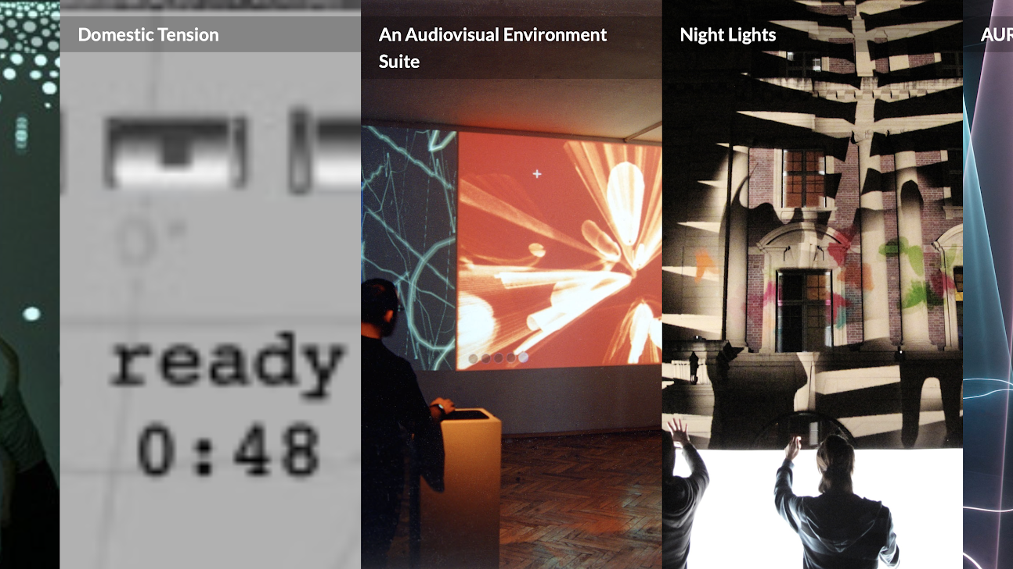
Art, Technology, Interactivity
Yuli Zhao

Slide 2
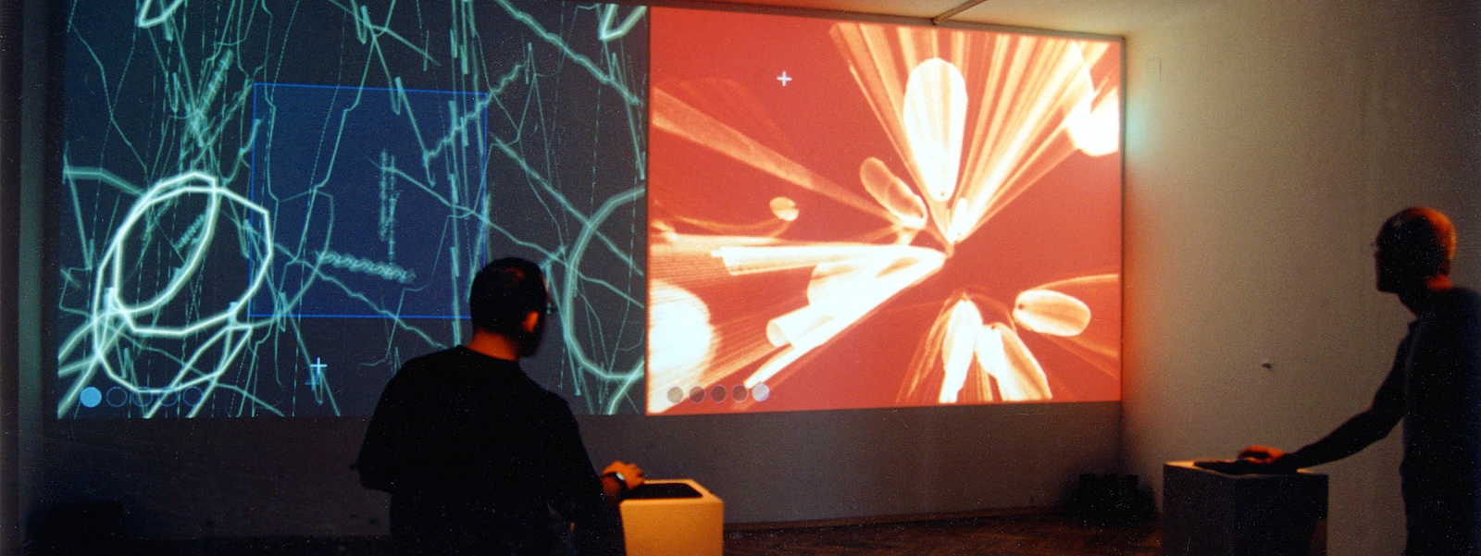
An Audiovisual Environment Suite
Golan Levin, 1998-2000
Notes:
The Audiovisual Environment Suite (AVES) is a set of five interactive systems which allow people to create and perform abstract animation and synthetic sound in real time. Each environment is an experimental attempt to design an interface which is supple and easy to learn

Slide 3
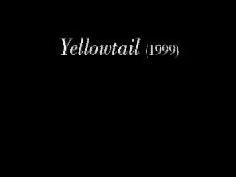
Yellowtail
1999
Notes:
repeats a user's strokes end-over-end, enabling simultaneous specification of a line's shape and quality of movement. When placed into an 'inverse spectrogram', these marks are sonified by an additive synthesizer.

Slide 4

Aurora
1999
Notes:
permits the user to create and manipulate a shimmering, nebulous cloud of color and sound. This glowing formlessness rapidly evolves, dissolves and disperses as it follows and responds to the user's movements

Slide 5

Floo
1999
Notes:
disperses and deflects soft-edged tendrils in response to the user's movements. Sound granules in a circular pitch-space create chorused drones as the tendrils grow

Slide 6

Loom
1999
Notes:
wraps an animated score around the spine of a user's mark. As the marks are perpetually redrawn, they are sonified by a curvature-sensitive FM synthesizer.

Slide 7
Warbo
2000
Notes:
allows the user to create animated compositions of glowing blobs. When a second cursor is played over the surface of the spots, it produces tones and chords from a Chebyshev waveshaping synthesizer.

Slide 8
Scribble Concert
Ars Electronica, 2000
https://www.youtube.com/watch?v=ucVFa7re6xI

Slide 9
Footballs
Golan Levin & Zachary Lieberman, 2006 https://vimeo.com/227566535
Notes:
Footfalls is an interactive audiovisual installation in which the stomping of the visitors’ feet creates cascading avalanches of bouncy virtual forms. In Footfalls, stepping and stomping sounds produced by the visitors’ feet are detected by microphones under the floor, and used to govern the size and number of virtual objects that fall from a six-meter high projection. The harder the visitors stomp, the more items fall. Using their silhouettes, visitors can then “catch” and “throw” these projected objects around.Footfalls is an interactive audiovisual installation in which the stomping of the visitors’ feet creates cascading avalanches of bouncy virtual forms.

Slide 10
Eyeshine
Golan Levin & Kyle McDonald, 2011 https://vimeo.com/222998856
Notes:
an interactive installation which captures, records and replays the retroreflections (red-eye effects) from the eyes of its observers. In doing so it presents an image wholly constructed through the process of being observed.

Slide 11
Domestic Tension
Wafaa Bilal, 2007
Notes:
Domestic Tension was one of a number of efforts by Bilal to highlight the violence and racism of US culture after 9/11, and to raise awareness about the suffering that Iraqis have faced for years.
Wafaa Bilal confined himself to a gallery space. He broadcasted over the internet 24/7, inviting viewers to watch and chat with him at all hours. The audience was also given the option of shooting Bilal with a robotically controlled paintball gun.

Slide 12
http://archive.rhizome.org/anthology/domestic-tension/

Slide 13
https://www.youtube.com/watch?v=F_L6BC9O0rY&list=UUt11epfyqEV5qBYNakUbARQ&index=35 https://www.youtube.com/watch?v=PtvvVbeaSHk&list=UUt11epfyqEV5qBYNakUbARQ&index=3 https://www.youtube.com/user/mewafaa/videos
Notes:
The project adopted the format of a first-person shooter videogame. Visitors could choose to fire or not, but they could only stand behind the gun, not in the place of the target.
Over 65,000 paint pellets were fired at Bilal over the course of the thirty-day exhibition, from more than 136 countries.

Slide 14
PomPom Mirror
Daniel Rozin, 2015 https://vimeo.com/128375543
Notes:
Rozin’s anthropomorphic "PomPom Mirror" features a synchronized array of 928 spherical faux fur puffs. Organized into a three-dimensional grid of beige and black, the sculpture is controlled by hundreds of motors that build silhouettes of viewers using computer-vision. Along its surface, figures appear as fluffy animal-like representations within the picture plane, which is made permeable by a ‘push-pull’ forward and backward motion of meshed ‘pixels’. Ghostly traces fade and emerge, as the motorized composition hums in unified movement, seemingly alive and breathing as a body of its own.

Slide 15
Fabric Mirror
Daniel Rozin, 2019 https://vimeo.com/317577759

